Slide 1
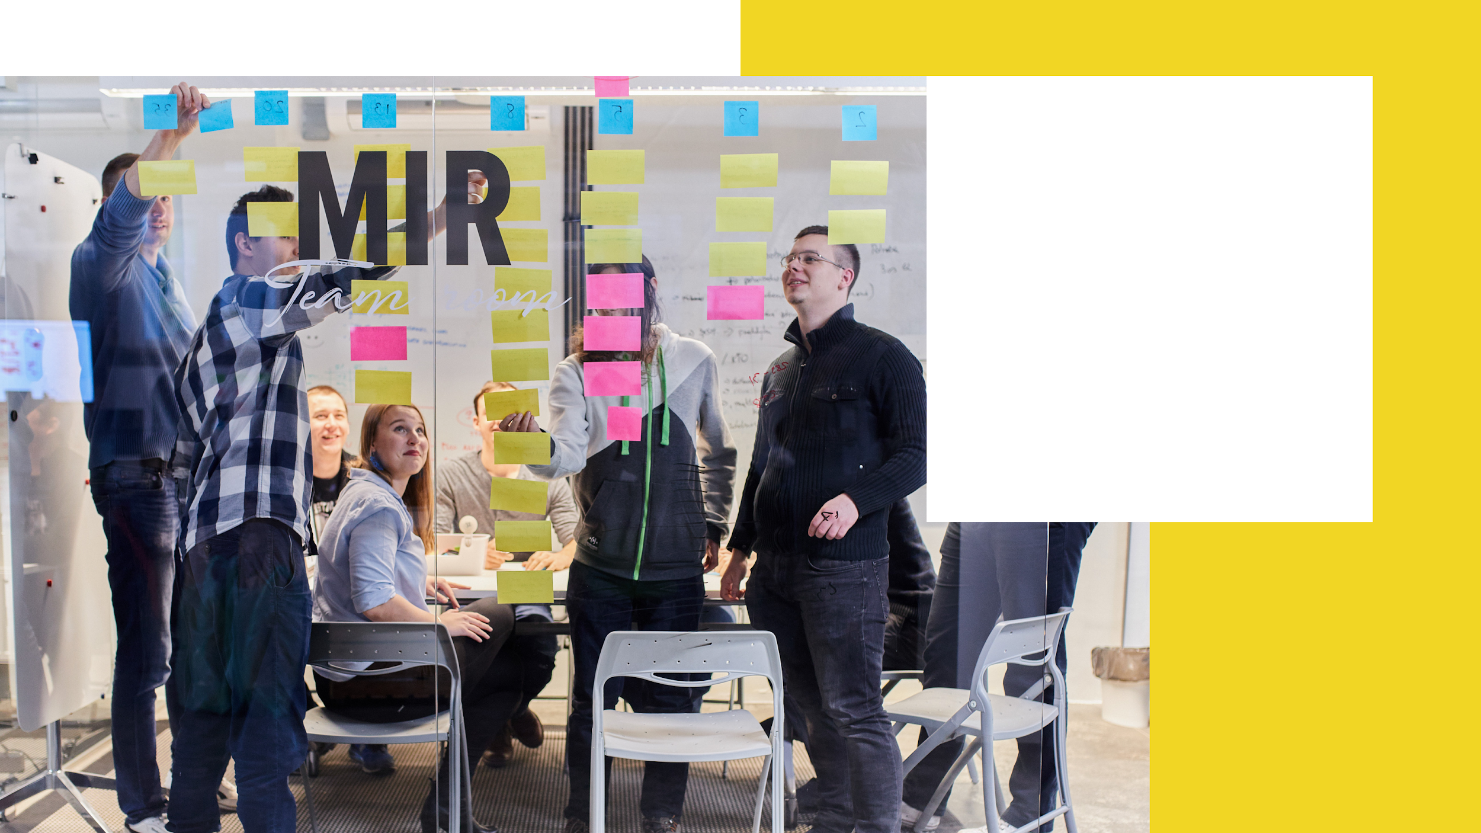
Product
Design and Development Company

Slide 2
01.
About Us
02.
Products
03.
Experience & Capabilities
Page 1 – 7
Page 8 – 17
Page 18 – 21
04.
Process
07.
Additional
case studies
05-06.
Our Standards & Hiring process
Page 22 – 27
Page 28 – 36
Page 37 - 48

Slide 3
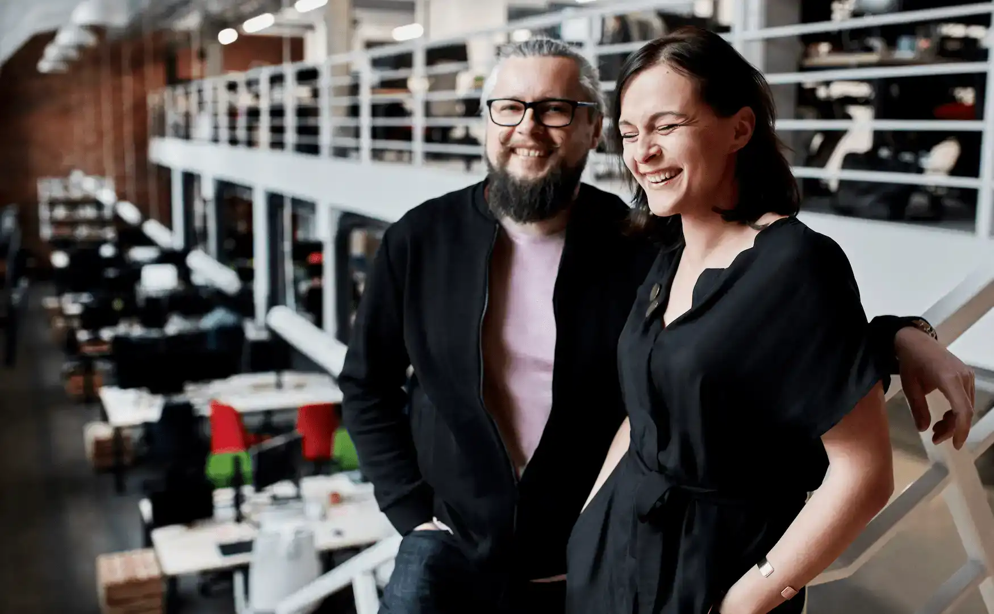
01.
About Us
01.a Who are we?
We are a digital product design & development company and your guide on the digital transformation journey.
Boldare emerged from the successful merger of Chilid, a web design company and XSolve, a software development company, and inherited their 16 years of experience working in global markets.
01.b What are we doing?
Full Cycle Product Development Services (Prototype, MVP, Product-Market Fit,
Scaling & Maturity)
Product Design and Development
Development Teams
Machine Learning Services
Digital Transformation Services
Read our story!..

Slide 4
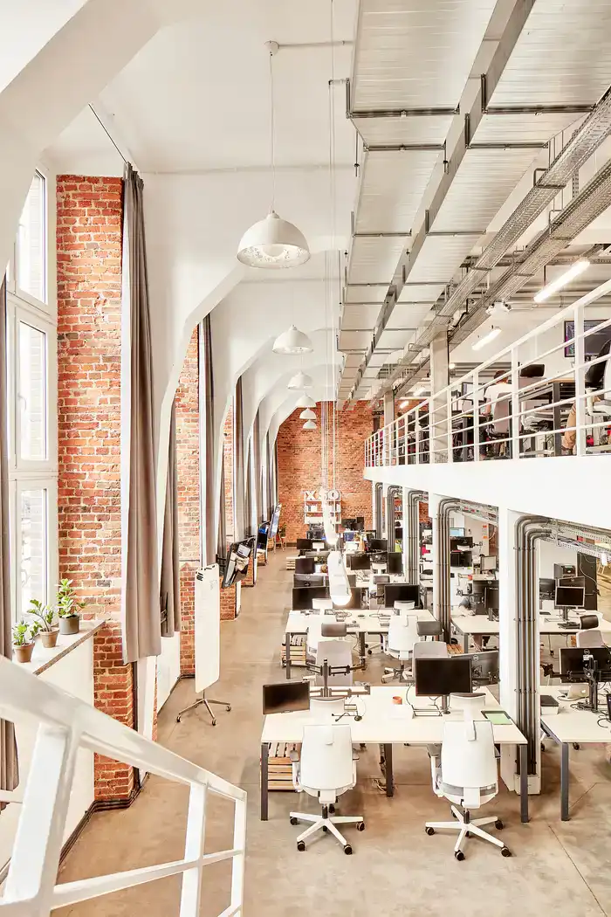
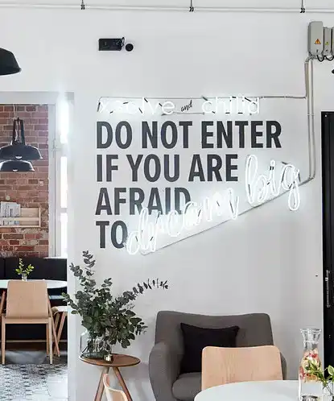
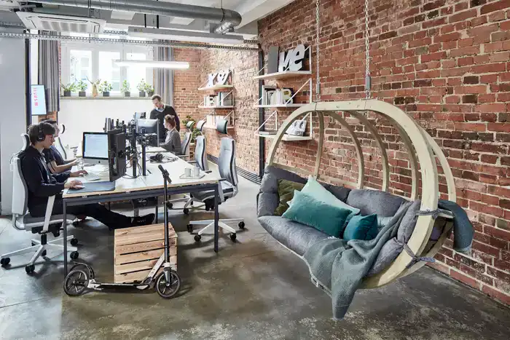
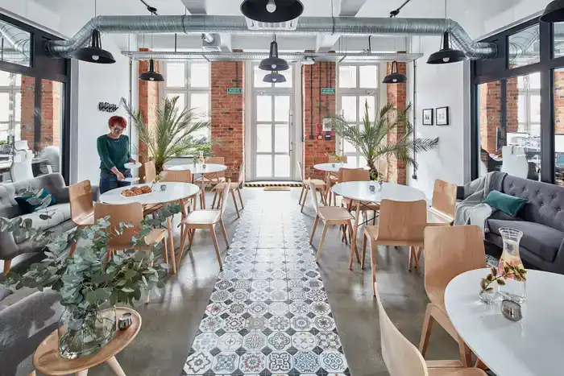
01.c Our offices
Boldare has four offices in the following cities:
Gliwice (Headquarters)
Warsaw (Capital City of Poland)
Wroclaw
Cracow
Our offices reflect our way of working: they're agile, collaborative spaces supporting flat structure and change.

Slide 5
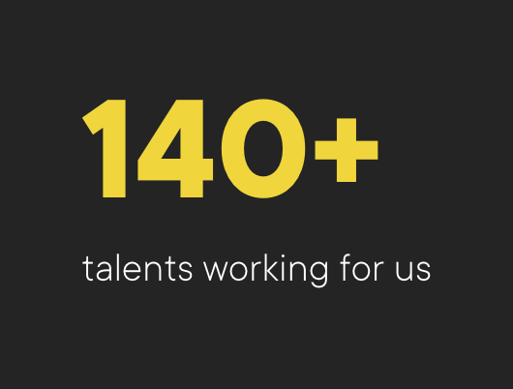
We're constantly evolving
25 persons with scrum.org certificates: Agile Project Manager, Professional Scrum Master, Professional Product Owner, Nexus.
Business & Products Change Management, P3O, MSP in Programme Management, Portfolio Management, Service Design Intensive UAl London.
59 technical and quality assurance certificates.
Our team is constantly learning and training - we follow technological trends but we are equally focused on increasing our delivery and organization management skills.
160+

Slide 6
Our experience
16
43
12
270+
years of experience
reviews on Clutch.co
honorable mentions
at Awwwards
digital products delivered
66 case studies with metrics and business goals.
43 reviews from our clients.
Our award-winning UI and UX and design concepts.
10 years under one roof to build a delivery culture.
GET TO KNOW THEM ALL
GET TO KNOW THEM ALL
SEE MORE BEAUTY
REASONS FOR THE MERGE
‹#›

Slide 7
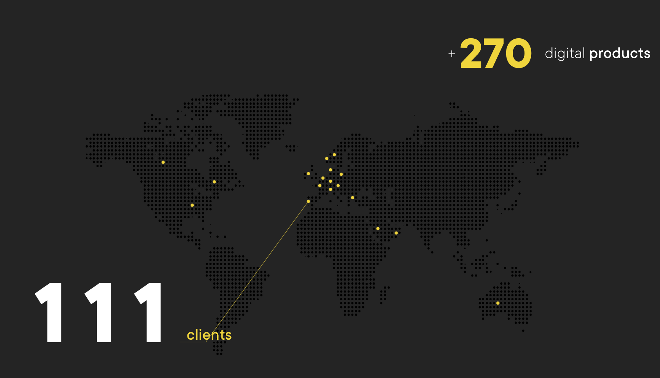

Slide 8
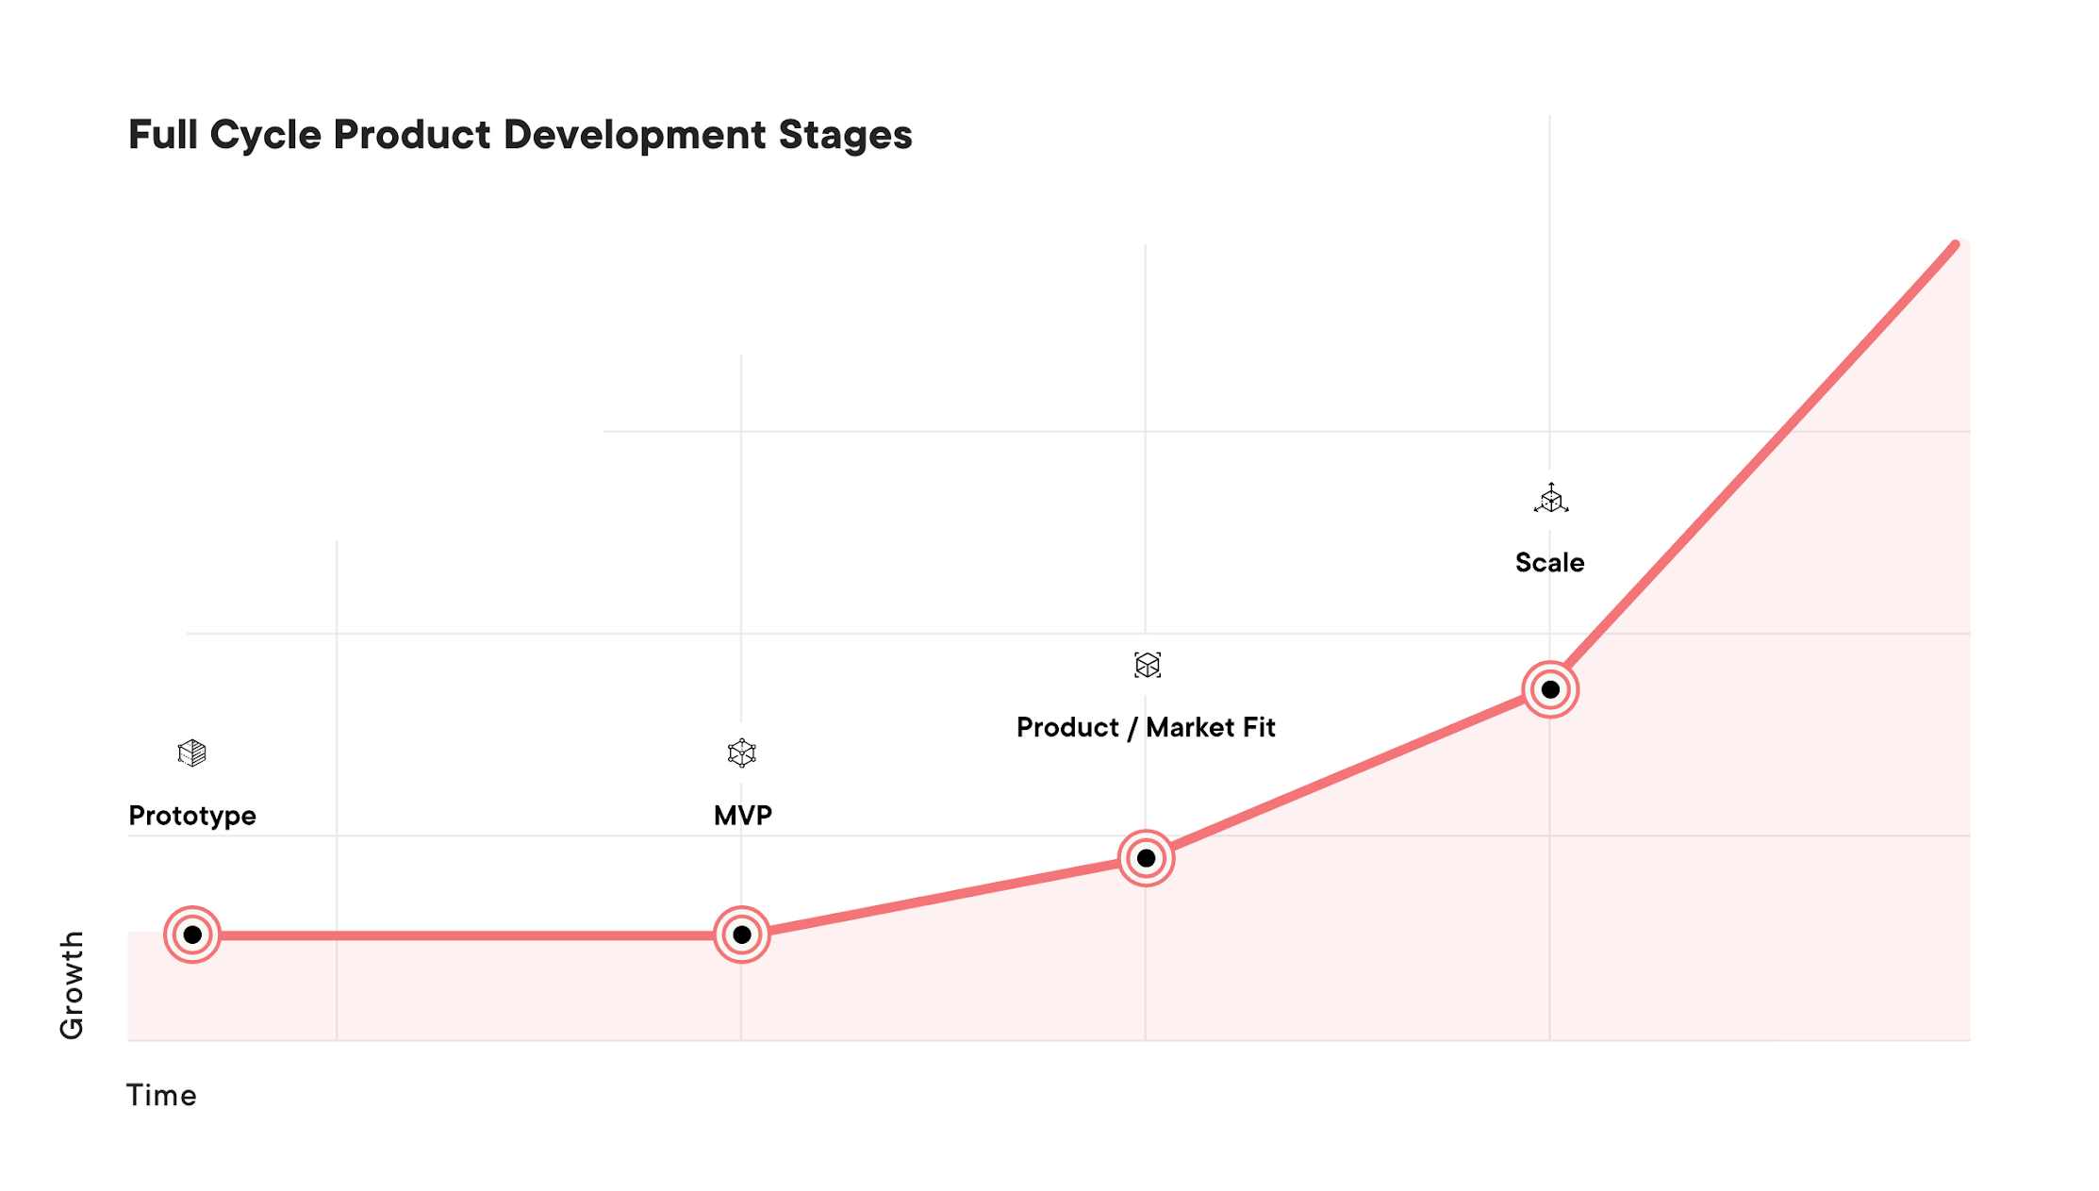
Full Product Development Cycle
Boldare
products
02.

Slide 9
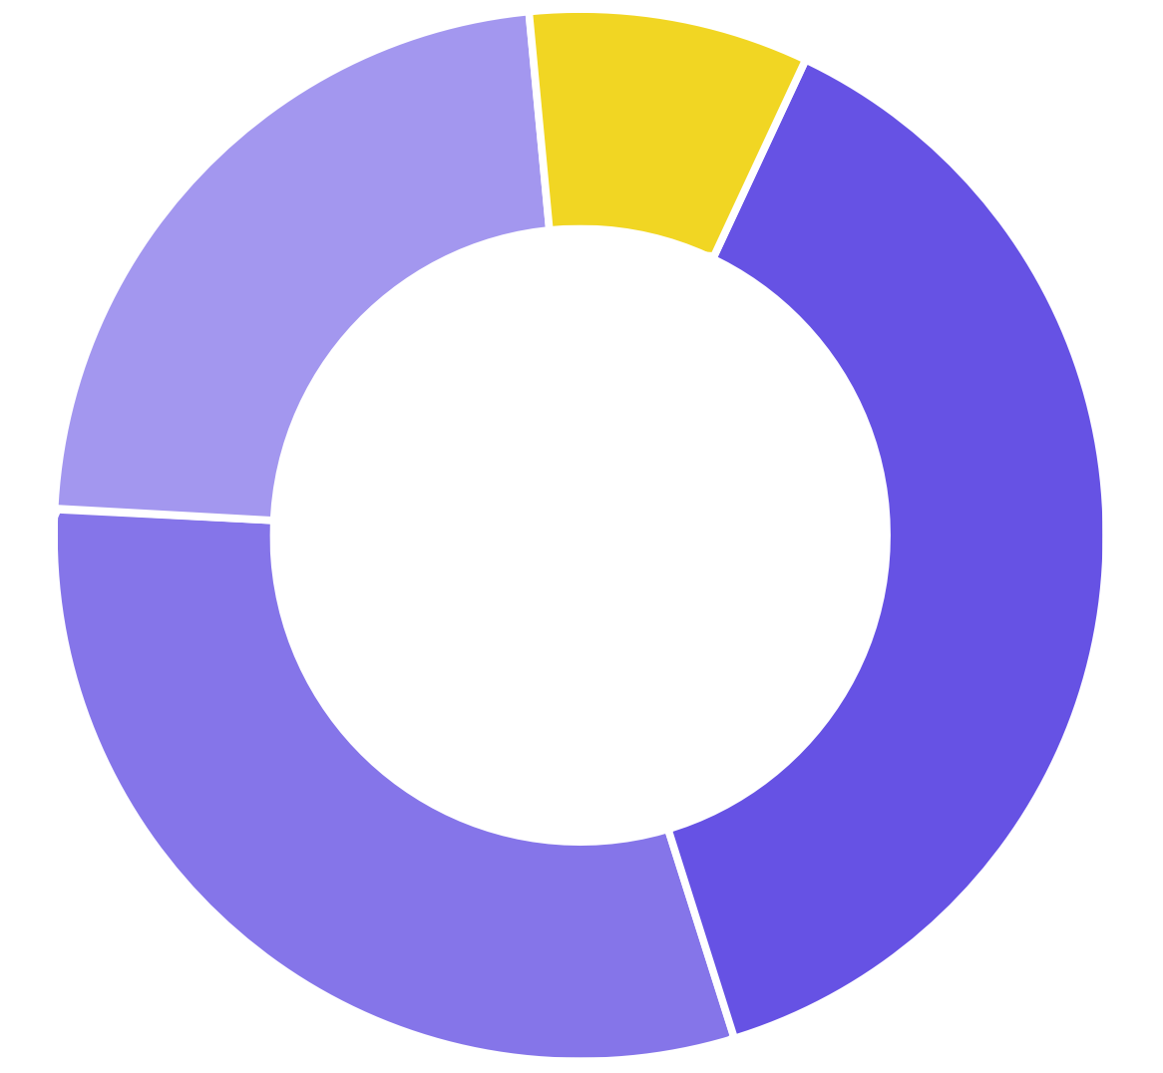
Boldare
products
2019/2020
02.
Other + Prototyping (11)
Scaling (29)
Amount of products built
MVP (49)
Product-Market Fit (39)

Slide 10
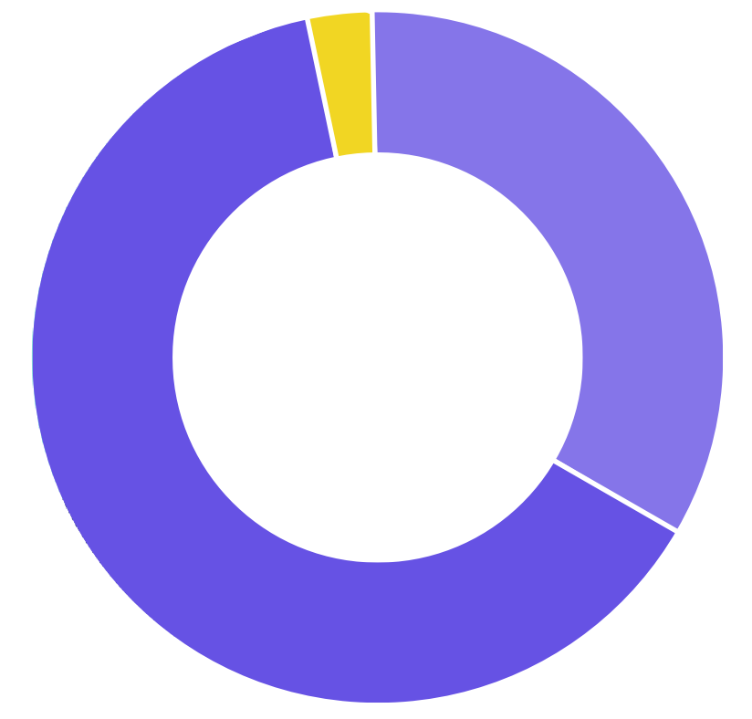
Revenue
2019/2020
02.
Other + Prototyping (3%)
MVP (33%)
Most of Boldare revenue comes from maturing products
Product-Market Fit + Scaling (64%)

Slide 11
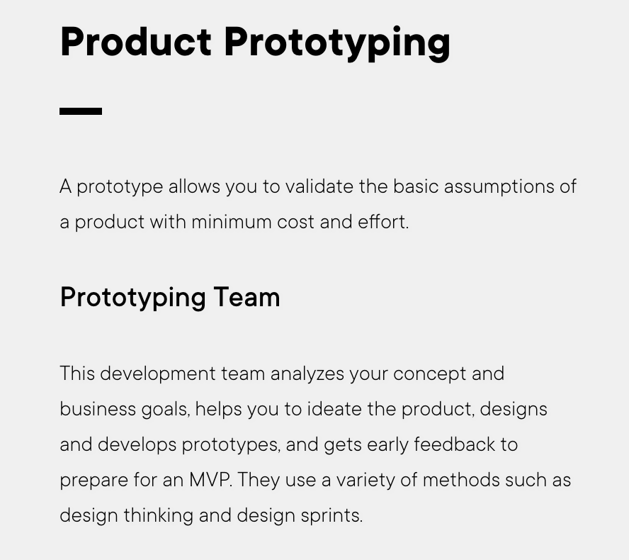
Team size: 2-3 members Timeline: 1-2 weeks Predictive Maintenance App Case Study
Delivery: 1-2 weeks Processes: Design Sprints, Design Thinking, Agile/Scrum Outputs: A clickable prototype ready for testing
Learn more →
2019 & 2020
6 prototypes validating new business ideas 15 prototypes supporting product/market fit stage 34 prototypes for scaling

Slide 12
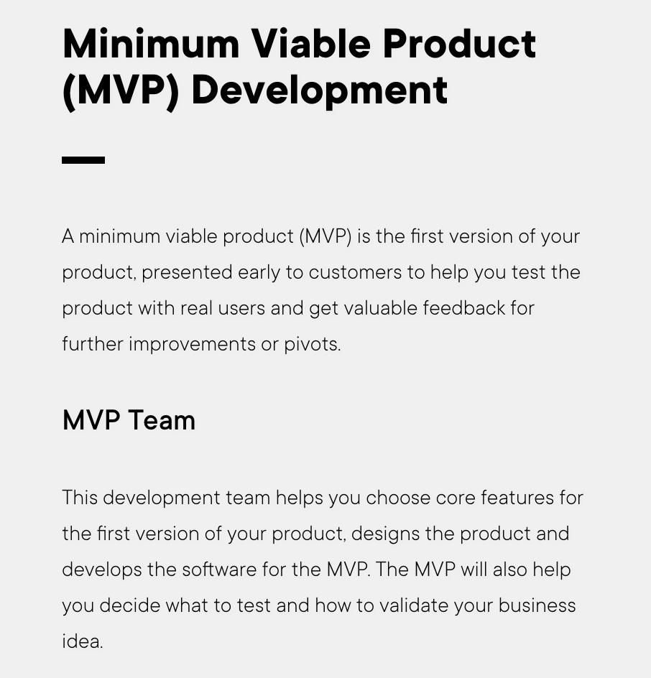
Team size: 3-5 members Timeline: 6-12 weeks Virgin Radio Case Study
Delivery: 6-9 weeks Processes: Design Sprints, Event Storming, Agile/Scrum Outputs: Product ready to go to market for validation
Learn more →
Mobile app and web MVP
43 Minimum Viable Products built for clients from France, Germany, Saudi Arabia, UAE, UK and USA.
JavaScript, Python, and Node.js
2019 & 2020
Custom Reporting Module integrated with B2B gas trading platform

Slide 13
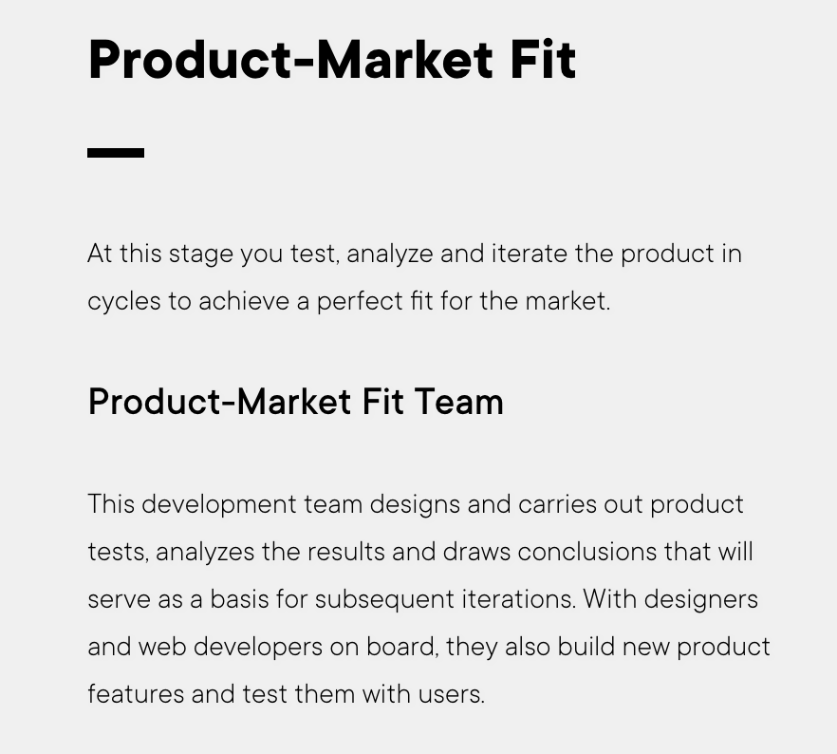
Team size: 3-8 members (depends on needs coming from market feedback) Number of teams: 1-6 interdisciplinary teams Timeline: 3 - 16 months HolaSpirit Case Study
SEPA payment application
27 Products built Teams working together with client teams, implementations simultaneous with agile transformation. JavaScript, Node.js, .NET, PHP, Java
2019 & 2020
Three government products in development, one central environment

Slide 14
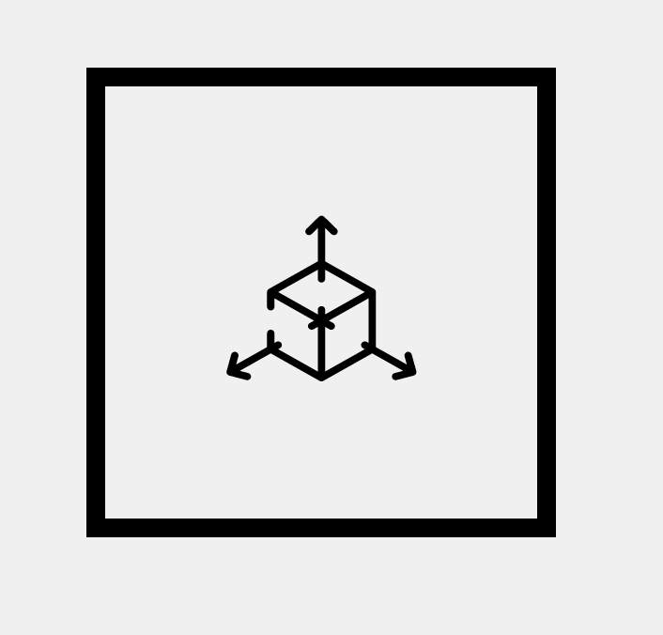
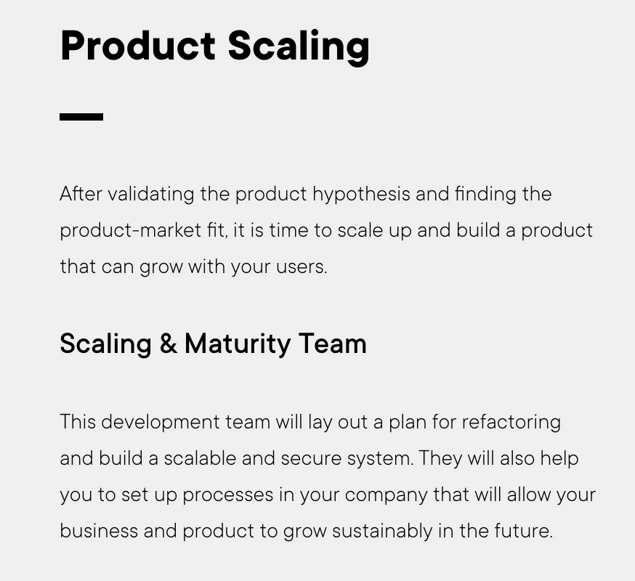
Team size: 3-5 members (depends on product growth strategy) Timeline: Usually quarterly based releases (1-5 years) Ionoview Case Study
Learn more →
5 years of cooperation, 3 products scaled
25 Products built Teams working together with client teams, implementations simultaneous with agile transformation JavaScript, Node.js, .NET, PHP, Java, Python
2019 & 2020
6 Boldare development teams of 12 working on products

Slide 15
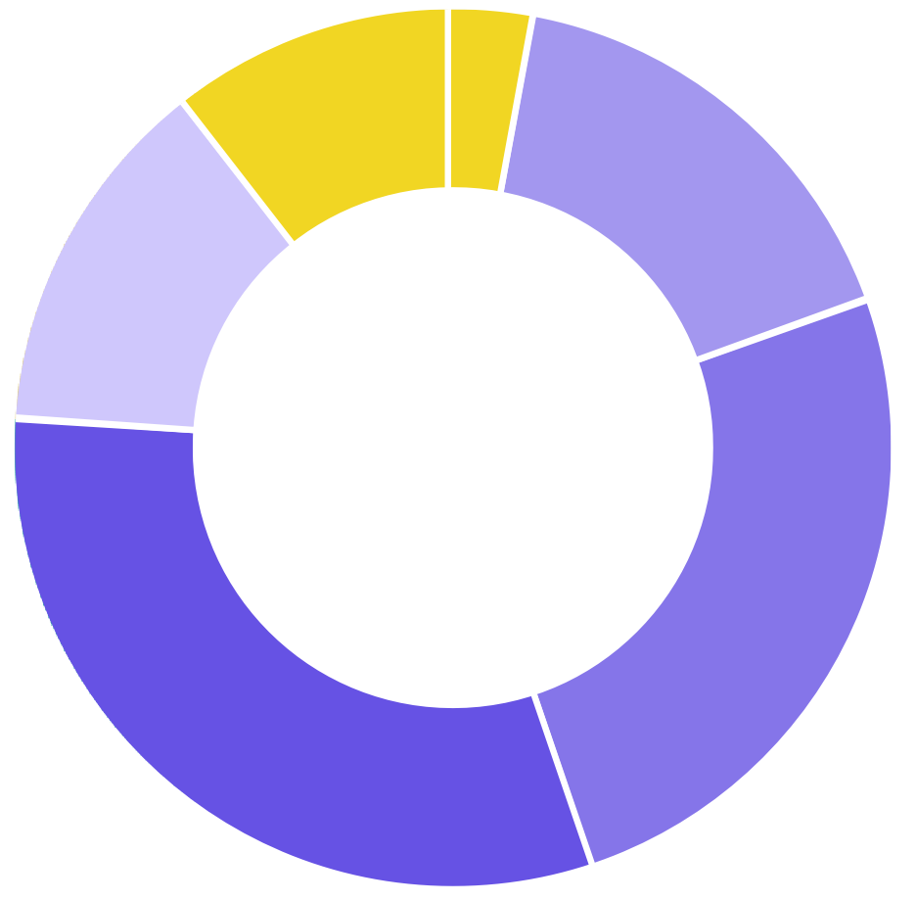
Industries
2019/2020
02.
Biotechnology (3%)
Other (10%)
Government (17%)
Renewables &
Environment (14%)
Information Technology
and Services (25%)
Management Consulting (31%)

Slide 16
-Awards-
Learn how our design can improve your digital product

Slide 17
-Awards-
Boldare honoured with a NextGen Enterprise Award!

Slide 18
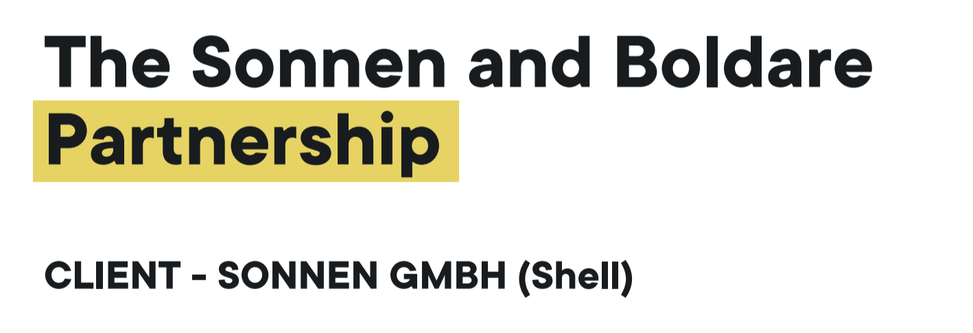
Key cooperations
03.
Check out our portfolio.......

Slide 19
BlaBlaCar and Boldare Partnership
More about this cooperation

Slide 20
Sonnen and Boldare Partnership
More about this cooperation

Slide 21
Rapid project kick-off with pre-assembled teams
Holistic approach to product development
No vendor
lock-in
Unique work ethic and innovative organizational system

Slide 22
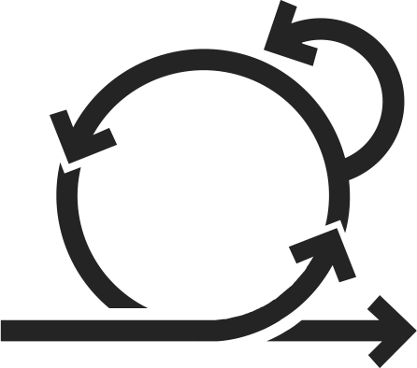
4.a Teams
Our Process
Scrum
As a digital product design and development company, our teams are cross-functional and accountable for delivering product increments to our clients. Each of the teams include the following roles:
Product Owner - responsible for the scope of the project, decisions, reporting, requirements, communication. Filled by a single person on the client's side.
Scrum Master - responsible for process, transparency, supporting the Product Owner in backlog management and the Development Team in effective work. Filled by a single person on Boldare’s side.
Development Team - a cross-functional team delivering product increments, in direct contact and collaborating with the Product Owner (and optionally other project stakeholders). Filled by developers and specialists, mostly on Boldare’s side, sometimes partially on the client's side. Every development team member speaks English.
04.

Slide 23
04.b Product development kick-off
Before we start development in sprints, we go through a collaboration and product kick-off. This is a series of events involving you and the whole team, led and facilitated by our Scrum Master. These include:
Meet the team
Discover the product
Plan a release
During this phase we all meet, discuss, and exchange information, but we also look for ideas, solutions, and create the product backlog. We choose from various techniques, which include event storming, impact mapping, user story mapping, and planning poker. We follow our checklists to make sure we cover all important topics.
These events usually take 1-3 business days, depending on product complexity.
Read an article on our blog: A step by step guide to Event Storming – our experience

Slide 24
04.c Delivering Product Increments
We follow the Scrum Guide (as defined by Scrum.org) to organize our development. We work in one or two-week sprints, delivering product increments and creatively collaborating with each other.
We have a Scrum Master on every one of our teams. The person filling that role helps the Product Owner to manage the product backlog, the team to self-organize, communicate and improve, and facilitates the scrum meetings. Every sprint includes:
Sprint Planning (Development Team, Product Owner, Scrum Master)
Daily Meeting (Development Team, Scrum Master)
Sprint Review (Development Team, Product Owner, Scrum Master)
Sprint Retrospective (Development Team, Product Owner, Scrum Master)

Slide 25
04.d Product Management
Product management in Boldare relies on a scrum team, comprised of a Product Owner, Scrum Master and Development Team. These three elements, along with a well-defined process and responsibilities, cover the project management. The scrum process we use is defined by Scrum.org and is described in the Scrum Guide.
04.e Budget, Scope and Change Management
We build products using scrum principles, where changes are natural and can be introduced to the product backlog at any time, and then reflected in the sprint backlogs.
The development scope and budget are managed by the following roles/process:
Development Team and Scrum Master are accountable for recommendations or decisions on how to approach the product development process, collaboration and feature/story solutions to find the best fit between development efficiency, product quality, and the client’s (Product Owner's) budget expectations/limits.

Slide 26
Development Team is responsible for continuous estimation of product backlog items and tracking their work to calculate the most accurate information about actual speed of delivery.
Product Owner is responsible for (non-technical) backlog decisions: scope (epics and stories), priorities (product backlog ordering), and formulating the most important scope to deliver in the current sprint and release.
Scrum Master and Development Team are responsible for meeting the predicted delivery dates for releases (for example: when an MVP can be released), as defined by the Product Owner and estimated by the Development Team.
By constantly knowing the predicted delivery dates, scope, and Development Team size and structure, we estimate the budget for the release.
The above is continuously iterated, with all parties involved, and is actually the budget and scope management process for our software development. This gives the Product Owner (and other project stakeholders) more precise control and predictability than in any waterfall process or top-down controlled environment.

Slide 27
04.f Risk Management
First, identification of product development project risks is performed, at the product discovery workshops. We organize a meeting with project stakeholders to identify and plan responses to project risks.
During product development, risk management sessions are performed every iteration and included in scrum meetings. The whole team is gathered for an iteration summary/planning meeting, which includes risk analysis.
By gathering frequent feedback from the team (including the QA roles), the Product Owner can react quickly and reduce problems before they really appear.
Every time a risk is identified, we communicate it to project stakeholders, including the possible consequences and proposed solutions or actions to address the risk item.
04.g Reporting
After each sprint, the Product Owner and other product development stakeholders receive a summary of the sprint, which includes a summary of the delivered product backlog items, a sprint burndown chart, the key decisions taken, risks identified, and actions needed.

Slide 28
05.a Coding Standards
Our Standards
Our teams always follow coding standards to provide a consistent, easy to understand and maintain codebase. Depending on technology, we choose from the best common standards to comply with. Constantly moving forward, we’re implementing the best new solutions for our projects, using reliable frameworks, tools and trends in technology.
05.
05.b Definition of Done
Every functionality or change in code we deliver meets the criteria listed in our definition of done, which ensures quality and consistency in our delivery.
When starting out on a collaboration, we always agree what ‘done’ means. Our standard Definition of Done states that a user story or bug from the product backlog is done when it is (see next page)...

Slide 29
DEFINED
There's common understanding between the devs and the Product Owner as to how it should look and behave.
IMPLEMENTED
It's coded along with automated tests, if required. Designs are fully implemented with RWD.
INTEGRATED
It passes its own tests (if any) and all tests in the project pass our CI environment.
CHECKED
It passes manual testing by a developer (before CR).
REVIEWED
It has had its code reviewed and accepted by another developer.
It has been tested and accepted by another developer (i.e. QA\E, QA\BA, or other programmer). It has been accepted by the Product Owner (during a sprint review or earlier).
ACCEPTED
DELIVERED
It has its code committed to a repository. It is delivered to a proper application environment (preview, live, or other project-specific env.)

Slide 30
05.c Peer Coder Review
We have a code review process, which mandates every piece of code be reviewed and approved by at least one another experienced software developer. This, combined with continuous integration, automated tests and other practices ensures the high quality of our code and helps us to keep good programming practices in our software. This procedure is one of the most important processes we practice and we give it a lot of attention.
05.d Code Metrics
We regularly check our code with automated tools to measure the crucial indicators of well-designed code: cyclomatic complexity, repeated code, test coverage, etc. We use tools like Sonar, Jenkins, Travis CI and our proprietary extensions. With these outcomes we aim to improve our results by comparing data from reports and alleviating bottlenecks. Working with these tools allows us to achieve outstanding code coverage results.

Slide 31
05.e Automated Tests
Most of our teams contain a Quality Assurance Engineer (QAE), who supports the team with test automation, delivery, and maintaining and executing end-to-end regression tests. In many cases, it is crucial for the team to have such support to maintain the best quality and stability of the product over time.
In our work, we obey the following techniques and tools:
Behavior-Driven Development (BDD) approach to clearly translate business language into working code. We write acceptance scenarios using Gherkin notation, so they are clearly understandable, both by engineers and the business - this way of preparing scenarios increases our transparency.
Test-Driven Development (TDD) approach in coding, for faster and easier detection of bugs in the initial phase of software development.
Automation tools and frameworks to write functional tests, such as Selenium WebDriver, Protractor, Jasmine, Selenide, Appium, Sikuli and others, depending on the project specification and target devices.
To deliver the best matched and effective tests, we prepare test suites covering user stories from the product backlog and other scenarios.

Slide 32
05.f Continuous Integration
We use Continuous Integration (CI) in our development. We merge code frequently, which helps to avoid integration problems. We use leading platforms like Travis CI or Jenkins CI with a set of automatically generated quality reports of our code. This ensures that only code which passes all the tests and quality metrics will be delivered.
We use CI tools to schedule time-based and event-based automated test runs to regularly check for regression and provide immediate feedback to the team about actual code and quality status.
These tools and our regular scheduled time-based regression tests help us to vastly improve our code quality and it is the first level of code verification.

Slide 33
06.a Selection process
Hiring Process
Summary
We use various professional employer branding initiatives, designed by our recruitment marketing team. These initiatives are a very important phase of the recruitment process that enables us to attract the most skilled candidates.
Selection process:
CV analysis (we pay extra attention to the history of employment of the candidates - experience in similar positions, nature of projects and tasks performed so far, work history, the level of knowledge, the level of fluency in using English).
First meeting - arranged in our office or online. During the meeting we verify:
technical knowledge and skills (technological stack, good practices in programming, knowledge of architectural patterns, ability to write tests),
experience in working on commercial projects (direct cooperation with a client and scrum team - level of business skills),
06.

Slide 34
communication skills (both in Polish and English),
ability to work effectively in a team (responsibility for own work and the product, transparency in sharing the effects of own work, ability to deal with difficult situations),
development potential (motivation to deepen knowledge and skills, ability to set development goals).
Programming exercises to solve at home (the task is analyzed by an experienced developer, and the conclusions are written down in the form of a feedback sheet).
Based on the conclusions from the recruitment interview and the recruitment task, we provide complete feedback to the successful candidate with their development goals for the trial period (3 months of cooperation).
Our recruitment process is of vital importance for ensuring there is a solid match between the candidate and the existing team. It does help to ensure mutual satisfaction from the collaboration within the team and the company.

Slide 35
06.b Core values we are looking for
We are looking for people, who are:
Cooperative - they are able to work effectively as part of the team.
Responsible - in a difficult situation they tend to be focused on finding a solution instead of blaming others.
Trustworthy - they fulfill their obligations.
Showing a proactive learning approach - they are eager to develop their knowledge and to teach others.
Communicative - they are able to clearly express their mind to the team and to the client.
Open-minded - they are able to look for new solutions and to question older and/or less effective ones.
Business focused - they are able to propose solutions which are tailored to the client’s business goal and their user needs.

Slide 36
06.c Required skill set
We are looking in people with:
Exceptional communication, self-organization, and time management skills.
Very good analytical and problem-solving skills, client-facing and stakeholder management.
A proactive, driven personality and will to make a difference at an organizational level.
A focus on continuous improvement of their own performance.
An excellent command of written and spoken Polish and English.
The ability to find areas for improvement and propose relevant solutions at an organizational level.
Sufficient technical knowledge to discuss project-related issues with clients.
Experience with agile work environments (e.g. agile risk management).
Experience with managing change in organizations.

Slide 37
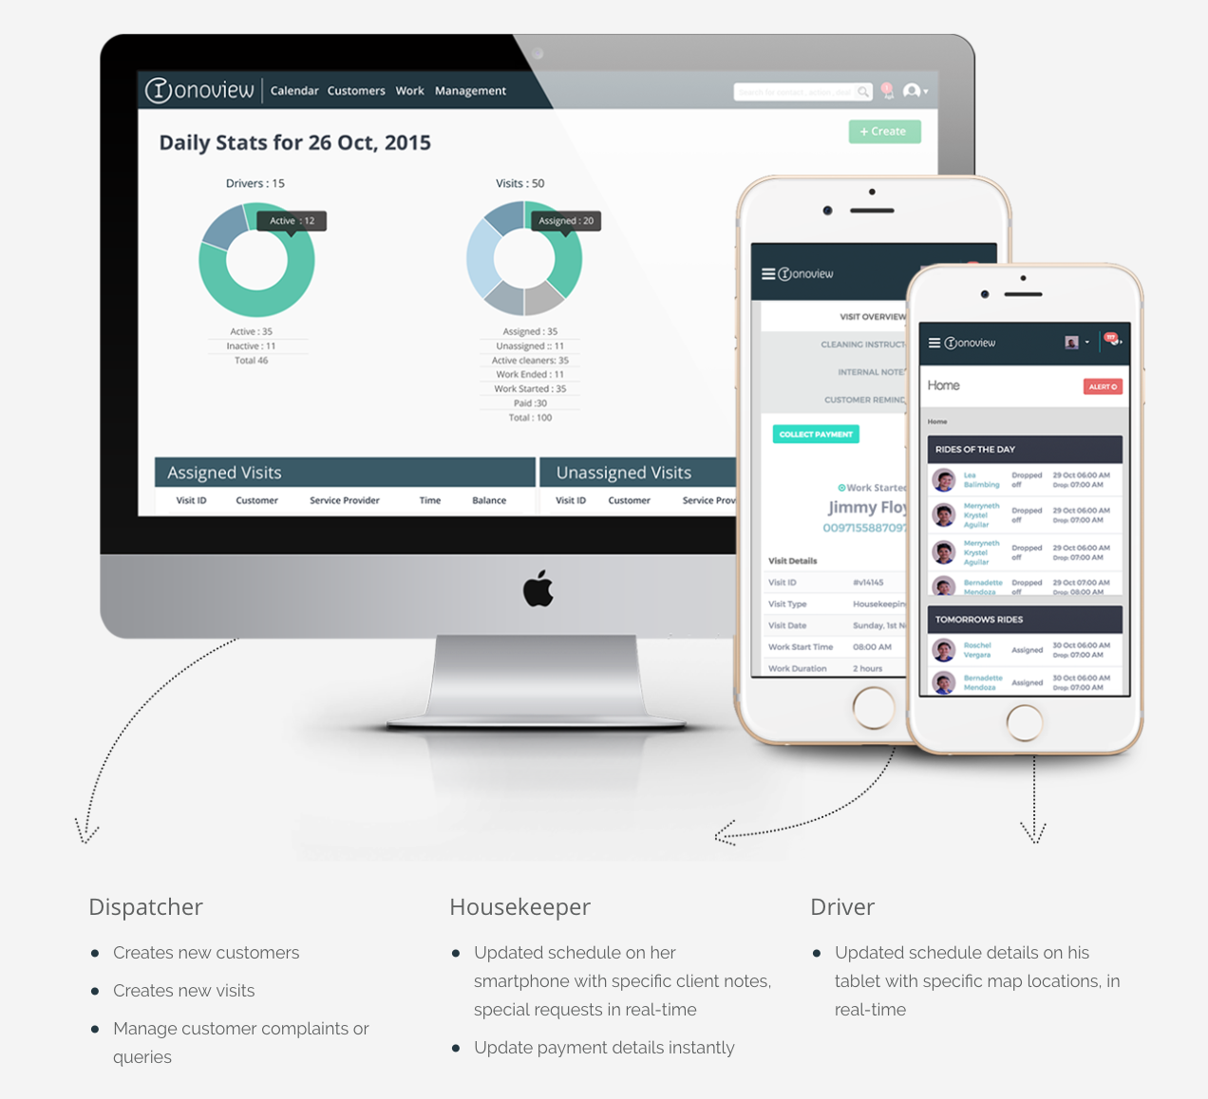
07. Additional case studies
Ionoview
Products for: Matic Delivery: The improvements made to Ionoview (SaaS app) have helped the client raise $3 million in investment and the B2B users of the product have reported a 10-fold growth thanks to their web apps.
“
“We contacted around 20 companies from around the world. We researched all of their profiles and operating techniques, but Boldare stood out as the best.”
Issam Najm, CTO @Matic Services
Ionoview Case Study

Slide 38
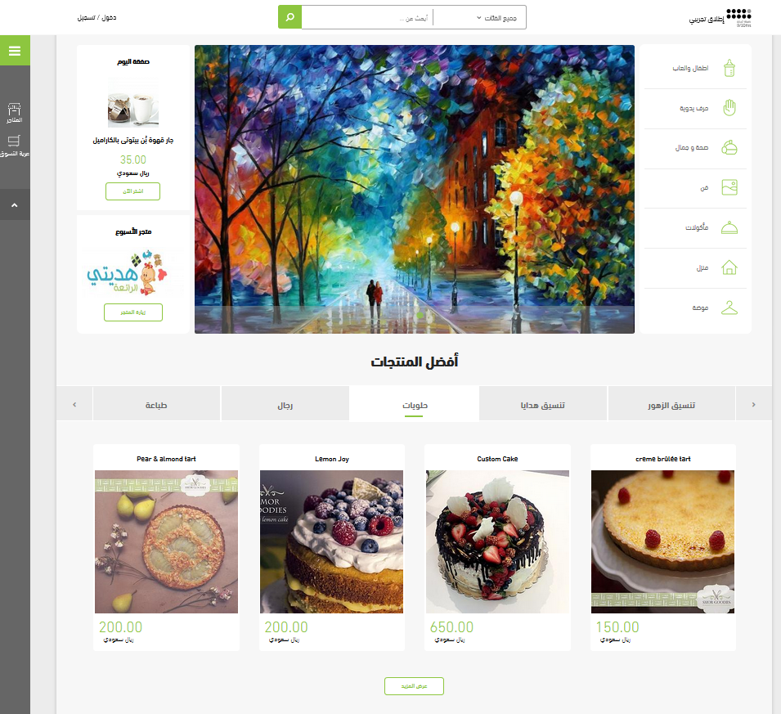
07. Additional case studies
Tojjar
Products for: Takamol Holding Delivery: MVP of the e-commerce platform within a 6-week deadline, and 3 years’ product market-fit & scaling.
“
“We moved away from our previous developer and made the switch to Boldare. After this, our process improved tenfold. They have a much better process with proper scrum, code reviews, automated testing, and a higher engineering quality.”
Development Business Manager, Takamol Holding
Case Study: How to deliver an e-commerce platform MVP in just 6 weeks

Slide 39
07. Additional case studies
Agnitio
Products for: Agnitio Delivery: Multi-device CLM system, which enables and empowers communication between sales representatives and stakeholders: doctors, nurses, pharmacists, and patients.
“
“Boldare was able to combine their experience and knowledge to quickly and professionally adjust to our requirements and expectations throughout all projects.”
Martin Frederiksen,
VP of Product Management

Slide 40
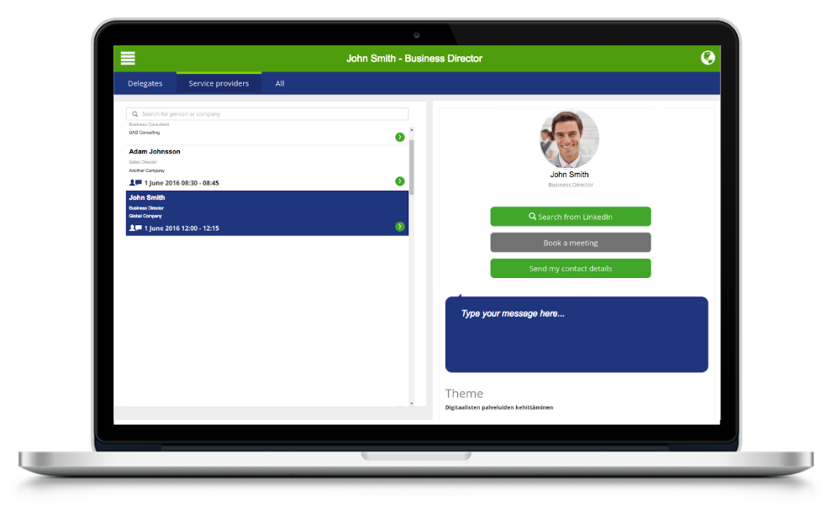
07. Additional case studies
Management Events
Products for: Managements Events Delivery: Complex sales and communication platform which supports the organization of exclusive, invitation-only events, and offers their clients the opportunity to have pre-booked meetings with the most potential customers and network with the forerunners in their field.
“
“We started off with 30 potential companies. Advanced 15 to the offer phase, 3 to the interview phase, two to the negotiation phase and finally Boldare to the partner phase.”
Tommi Suominen,
Group Procurement Manager

Slide 41
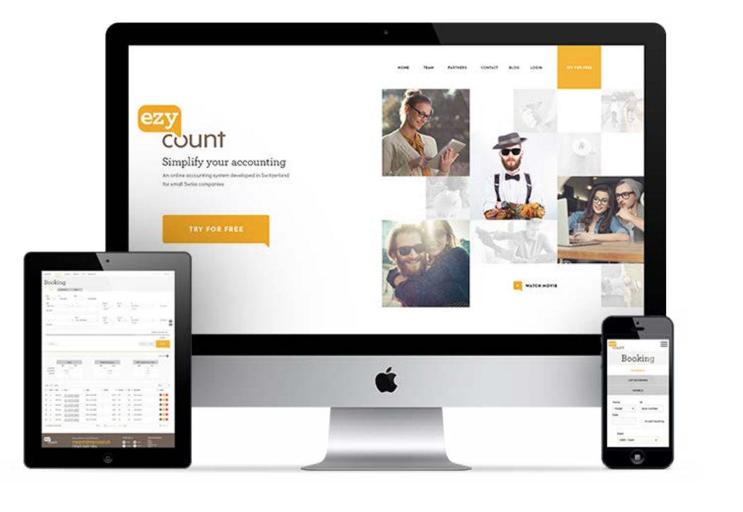
07. Additional case studies
EzyCount
Products for: Ezy Count Delivery: Prototype, market validation and MVP of an invoicing app for small businesses.
“
“I looked at many companies worldwide, and we chose Boldare because they were a good cultural fit, they had done good projects in the past, and we liked their approach. Boldare understood very quickly what we wanted, and they understood the challenges.”
Vivien Roduit, EzyCount CEO and Founder

Slide 42
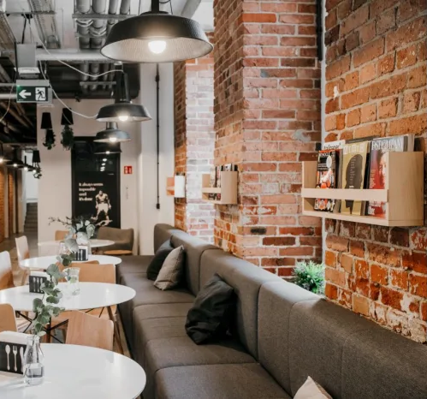
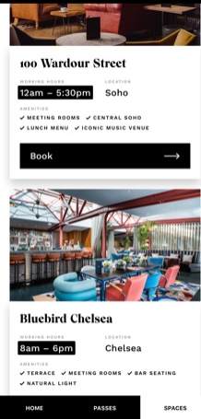
07. Additional case studies
The Workroom
Products for: Workroom Delivery: Web app & mobile app utilizing unused space in restaurants, connecting the venues with modern professionals.
“
“Thank you for all your amazing work! You've been a big part of what we see today as the Workroom - thank you for the creativity and all the hard work.”
Dominika Sadowska, Product Owner, The Workroom
Visual Case Study of The Work Room on Behance.

Slide 43
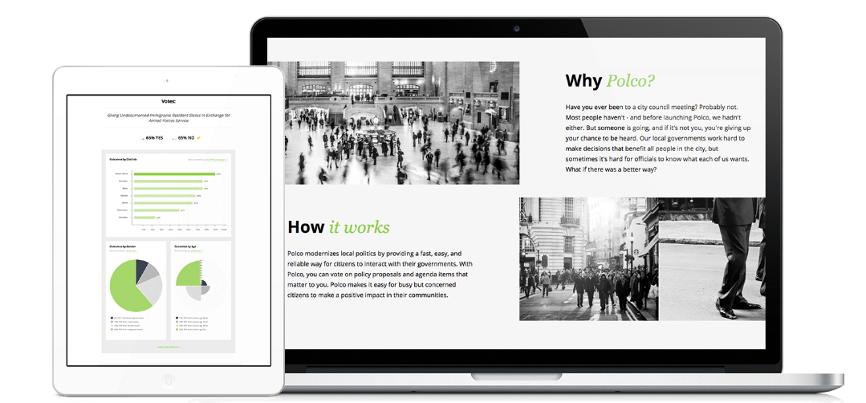
07. Additional case studies
Polco
Products for: Polco US Delivery: Real-time polling and digital community debates on US politics - prototype, MVP and product-market fit.
“
“Boldare seemed to be thinking of things we hadn’t thought of before, which we appreciated. It’s been a good experience.”
Alex Pedersen, COO Polco.us
Case Study of cooperation with Polco.us

Slide 44
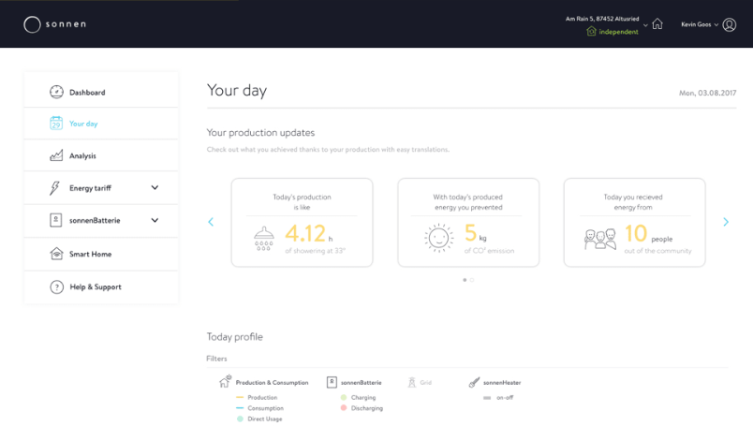
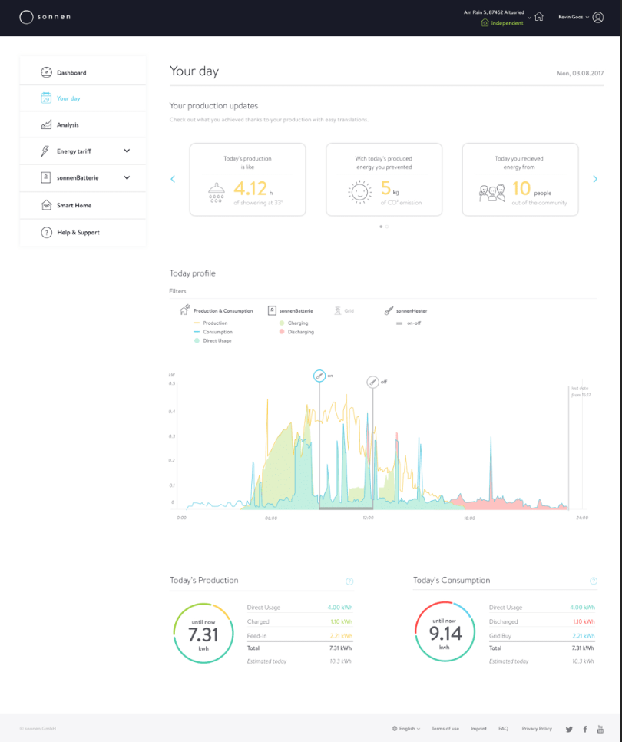
07. Additional case studies
Sonnen Customer Portal
Product for: Sonnen (recently acquired by Shell) Delivery: MVP of the customer portal
“
“The Boldare team really feels like they are sonnen employees. They work on an equal footing and collaboratively with our team members.”
Norbert Baumann, VP Research & Development / Digital

Slide 45
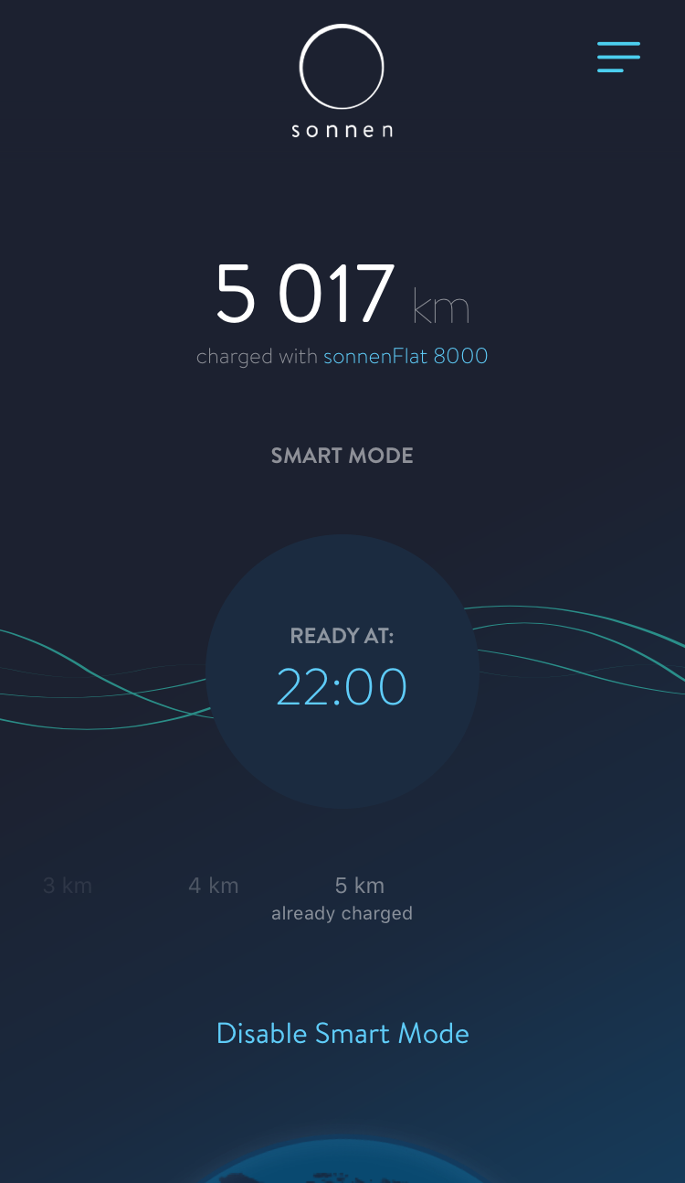
07. Additional case studies
SonnenCharger
Product for: Sonnen Delivery: Intelligent mobile app to control and gain an overview of the car charging process.
“
“First, their company culture really fits us well, especially their startup atmosphere, their agility, and the engagement of the team members. Second, we appreciate the technical qualifications of the developers. Third, they made themselves available very quickly. Finally, we are impressed with how the team works well together; they give each other honest feedback and communicate very well.”
Norbert Baumann, VP of R&D Digital Sonnen GmbH

Slide 46
07. Additional case studies
Sonnen Machine Learning
Product for: Sonnen Delivery: Data from over 15,000 historical paper documents digitized.
We have managed to automate the digitization and database cross check, with about 80% accuracy, reaching the client’s KPI of 70-80%. The delegation of the task to the algorithm running on the client’s side has also eliminated the risk of a sensitive data breach.
‹#›

Slide 47
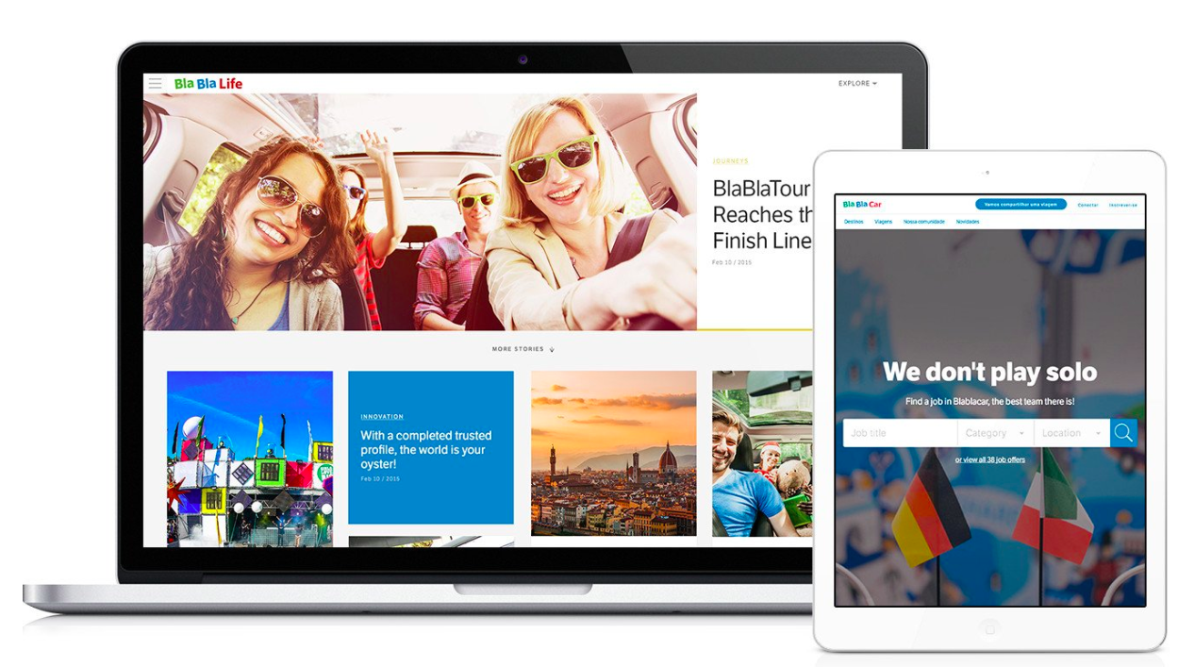
07. Additional case studies
BlaBlaCar
Products for: BlaBlaCar Delivery: We’ve helped BlaBlaCar, a unicorn startup to beat the competition and expand to 27 markets worldwide, having been their first external development partner.
“
“Boldare made remote cooperation super easy.”
Zeynep Esin, BlaBlaCar Product Manager
Case Study of cooperation with BlaBlaCar

Slide 48
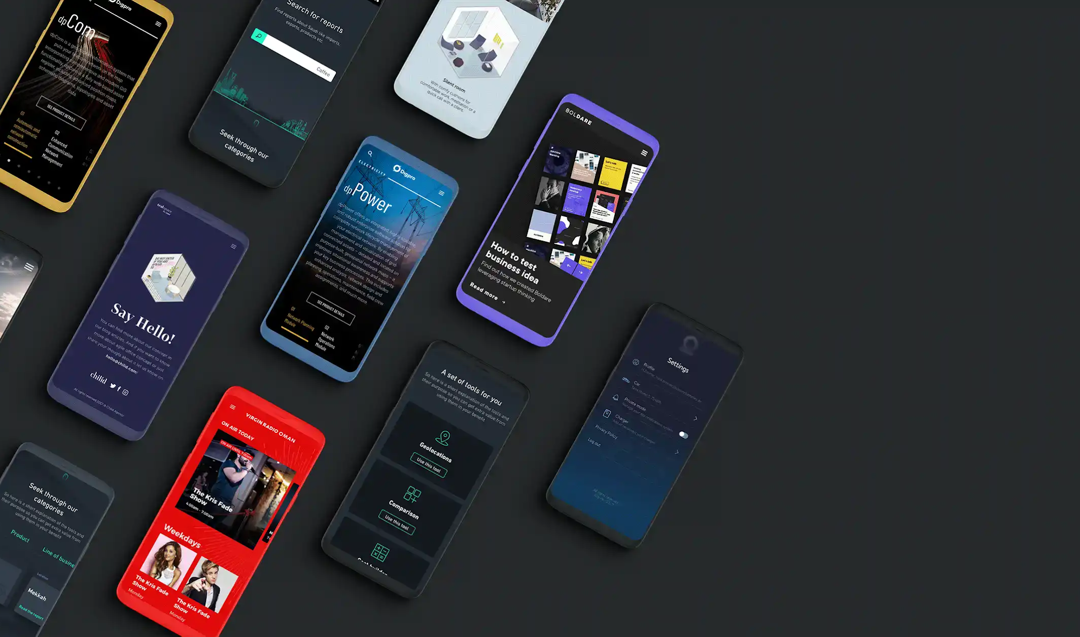
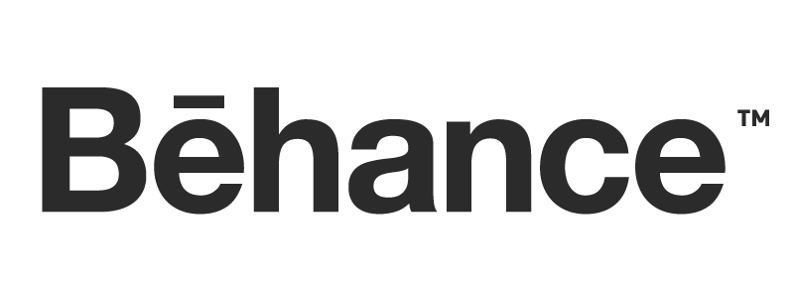
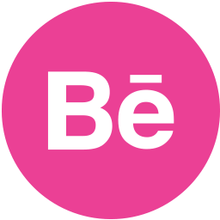
Check our............
& .............
‹#›

Slide 49
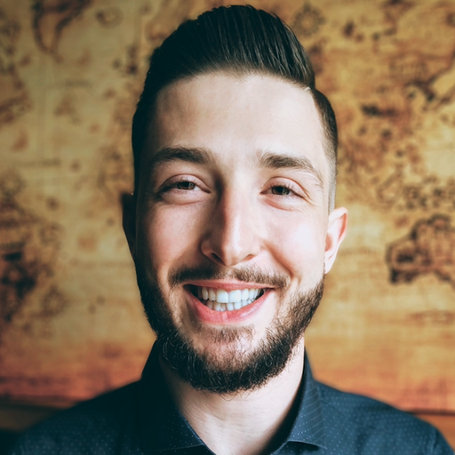
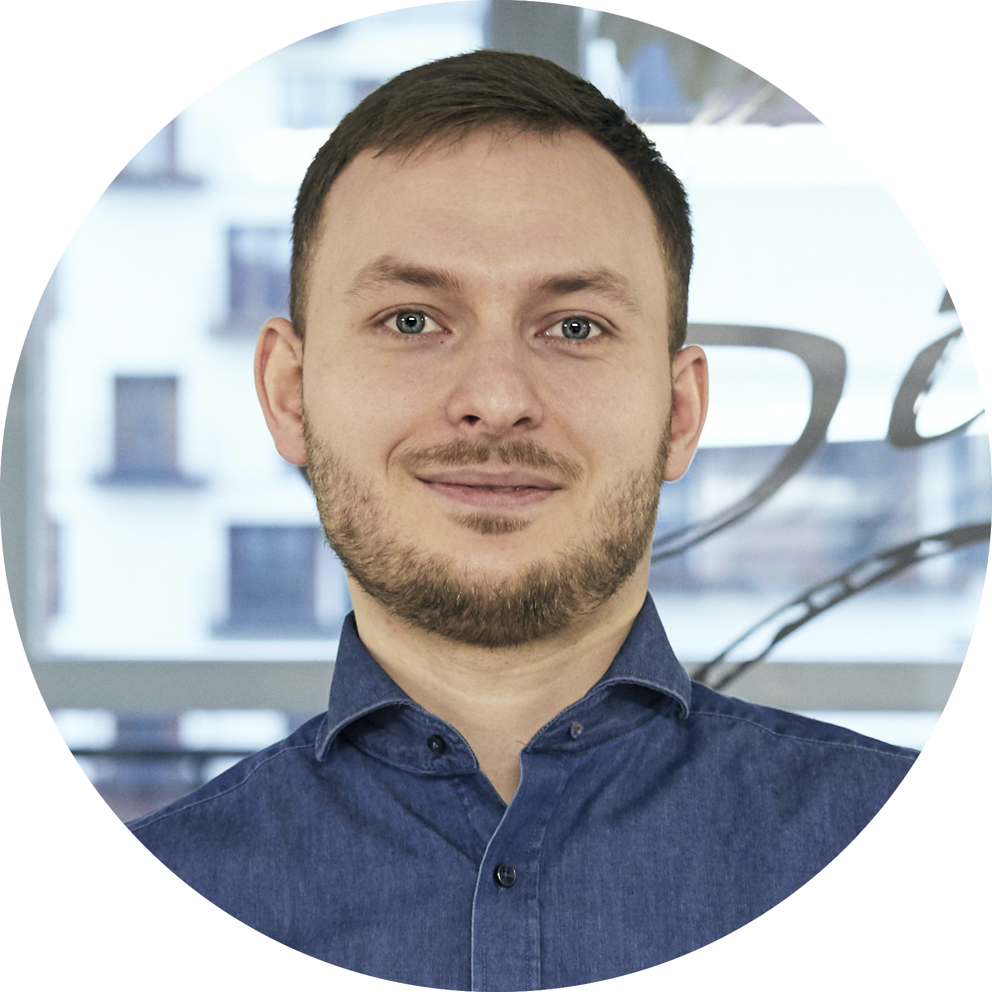
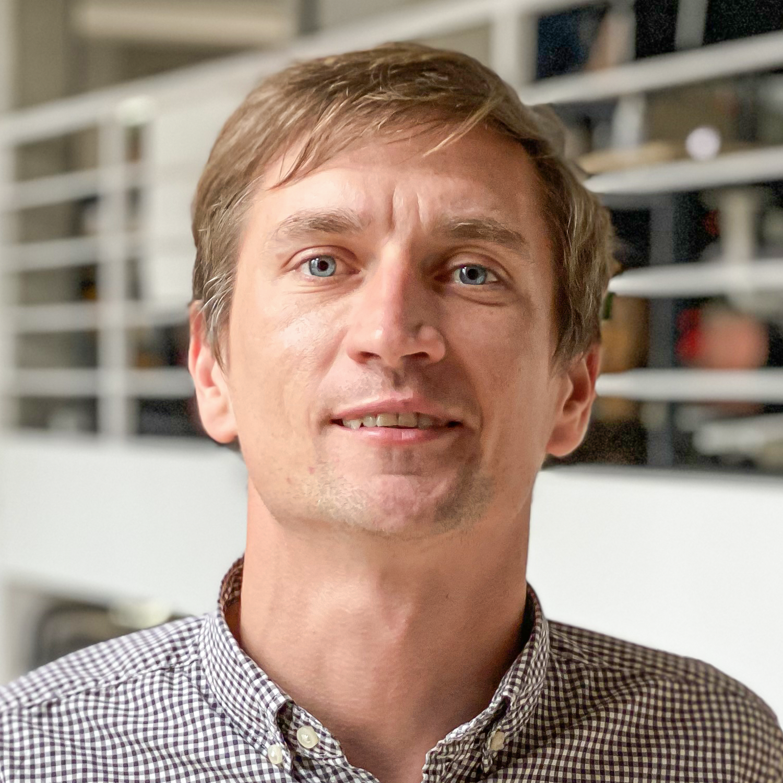
Business Development
adam.surdy @boldare.com
Business Solution Architect
slawomir.zagorski @boldare.com
Business Development mateusz.pachnik @boldare.com
Notes:
PROBLEM? Przeczytaj instrukcję!

Slide 50
www.boldare.com
Notes:
PROBLEM? Przeczytaj instrukcję!

